Slide 1
Modeling Cyberphysical Systems
Sayan Mitra
Verifying cyberphysical systems
mitras@illinois.edu

Slide 2
Map of CPS models
Dynamical systems
Differential inclusions
Discrete transition systems, automata
Markov chains
Probabilistic automata, Markov decision processes (MDP)
Continuous time, continuous state MDPs
Hybrid systems
Stochastic Hybrid systems

Slide 3
Outline
Hybrid automata
Executions
Urgency
Zeno
Hybrid stability

Slide 4
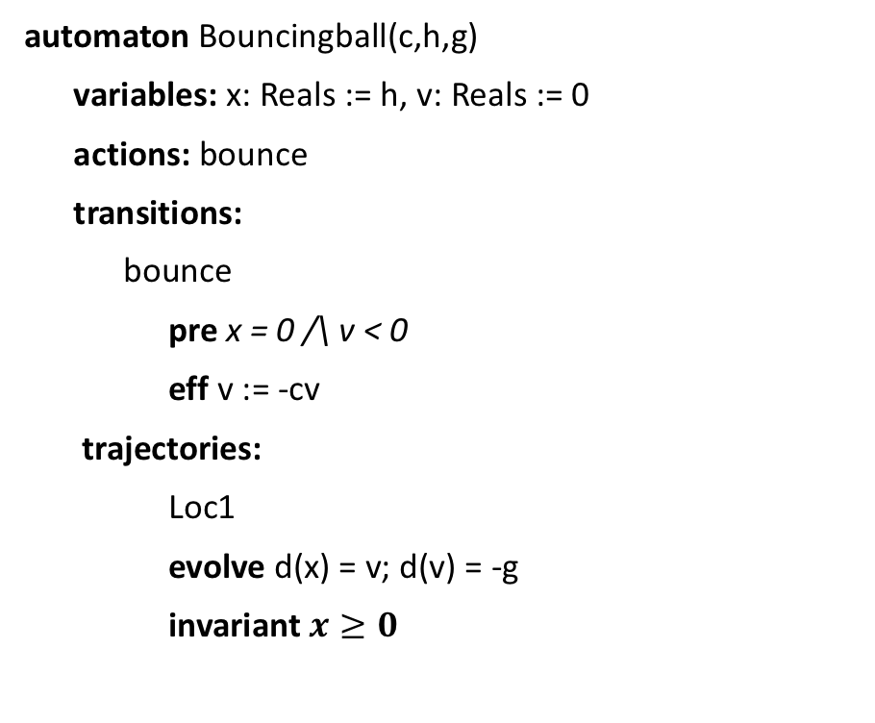
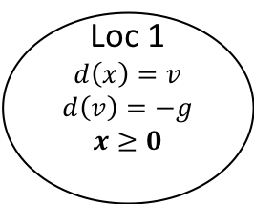
Bouncing Ball: Hello world of CPS
automaton Bouncingball(c,h,g)
variables: x: Reals := h, v: Reals := 0
actions: bounce
transitions:
bounce
pre x = 0 /\ v < 0
eff v := -cv
trajectories:
Loc1
evolve d(x) = v; d(v) = -g
invariant $x≥0$
bounce
x = 0 /\ v < 0
v’ := -cv
Loc 1
$$d\left(x\right)=v$$
$$d\left(v\right)=−g$$
$$x≥0$$
x:= h
mode invariant, not to be confused with invariants of the automaton
Graphical Representation used in many articles
Notes:
Guard, Precondition
Effect, Reset map
Invariance

Slide 5
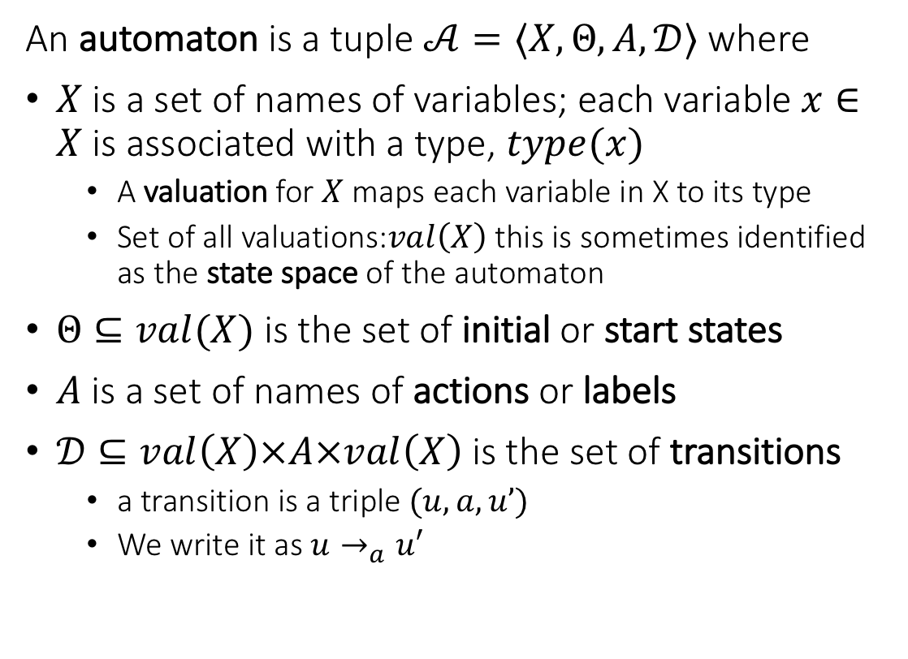
Recall from Lecture 1. language defines an automaton
An automaton is a tuple $𝒜=〈X,Θ, A, 𝒟〉$ where
$X$ is a set of names of variables; each variable $x∈X$is associated with a type, $type(x)$
A valuation for $X$ maps each variable in X to its type
Set of all valuations:$val\left(X\right)$ this is sometimes identified as the state space of the automaton
$Θ⊆val(X)$ is the set of initial or start states
$A$ is a set of names of actions or labels
$𝒟⊆val\left(X\right)×A×val\left(X\right)$ is the set of transitions
a transition is a triple $(u,a,u’)$
We write it as $u→_{a}u′$
automaton DijkstraTR(N:Nat, K:Nat), where K > N
type ID: enumeration [0,...,N-1]
type Val: enumeration [0,...,K]
actions
update(i:ID)
variables
x:[ID -> Val]
transitions
update(i:ID)
pre i = 0 /\ x[i] = x[N-1]
eff x[i] := (x[i] + 1) % K
update(i:ID)
pre i >0 /\ x[i] ~= x[i-1]
eff x[i] := x[i-1]

Slide 6
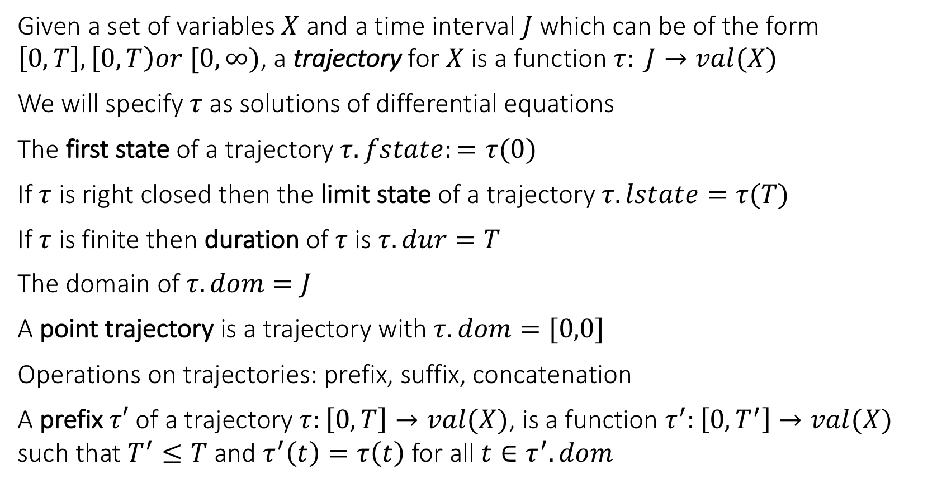
Trajectories
Given a set of variables $X$ and a time interval $J$ which can be of the form $\left[0,T\right], \left[0,T\right)or [0,∞)$, a trajectory for $X$ is a function $τ: J→val(X)$
We will specify $τ$ as solutions of differential equations
The first state of a trajectory $τ.fstate:=τ(0)$
If $τ$ is right closed then the limit state of a trajectory $τ.lstate=τ(T)$
If $τ$ is finite then duration of $τ$ is $τ.dur=T$
The domain of $τ.dom=J$
A point trajectory is a trajectory with $τ.dom=[0,0]$
Operations on trajectories: prefix, suffix, concatenation
A prefix $τ′$ of a trajectory $τ:\left[0,T\right]→val(X)$, is a function $τ^{′}:\left[0,T^{′}\right]→val(X)$ such that $T^{′}≤T$ and $τ^{′}\left(t\right)=τ\left(t\right)$ for all $t∈τ^{′}.dom$

Slide 7
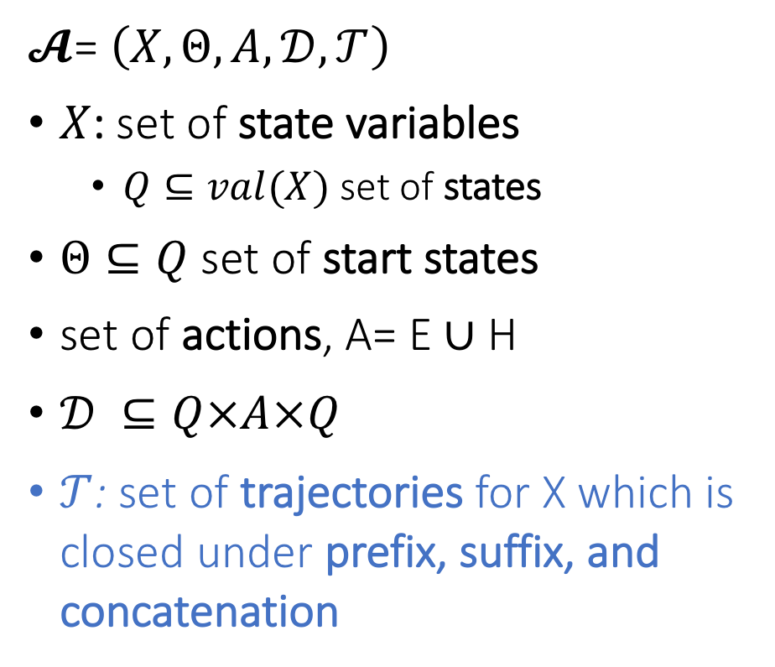
Hybrid Automaton
$𝓐$= $\left(X,Θ,A,𝒟,𝒯\right)$
$X$: set of state variables
$Q⊆val(X)$ set of states
$Θ⊆Q$ set of start states
set of actions, A= E ∪ H
$𝒟 ⊆Q×A×Q$
$𝒯$: set of trajectories for X which is closed under prefix, suffix, and concatenation
Notes:
Pick a couple of nice examples

Slide 8
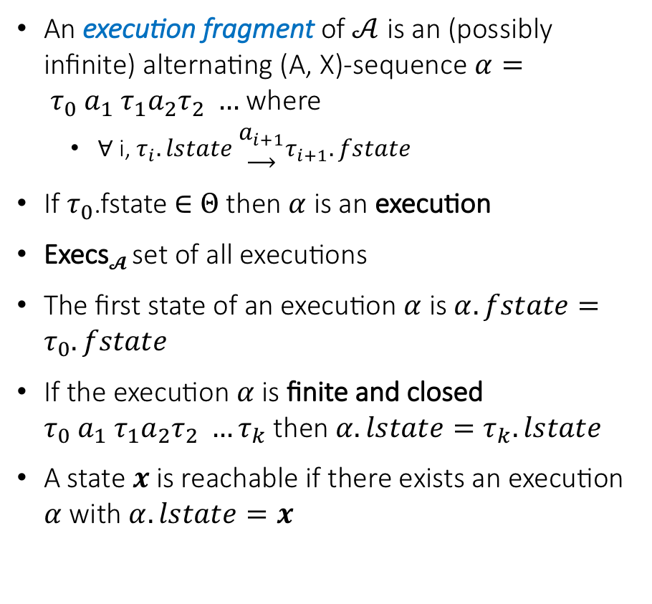
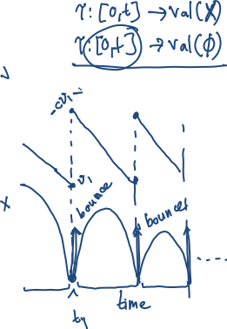
Semantics: Executions and Traces
An execution fragment of $𝒜$ is an (possibly infinite) alternating (A, X)-sequence $α= τ_{0} a_{1} τ_{1}a_{2}τ_{2} …$ where
∀ i, $τ_{i}.lstate \begin{matrix}a_{i+1} \\ ⟶\end{matrix}τ_{i+1}.fstate$
If $τ_{0}$.fstate ∈ $Θ$ then $α$is an execution
Execs$𝓐$ set of all executions
The first state of an execution $α$ is $α.fstate=τ_{0}.fstate$
If the execution $α$is finite and closed $τ_{0} a_{1} τ_{1}a_{2}τ_{2} …τ_{k}$ then $α.lstate=τ_{k}.lstate$
A state $x$is reachable if there exists an execution $α$ with $α.lstate=x$

Slide 9

Thermostat variations
automaton Thermostat(u, l, K, h : Real) where u > l
type Status enumeration [on, off ] actions
turnOn; turnOff;
variables
x: Real := l loc: Status := on
transitions
turnOn
pre x≤l ∧ loc=off
eff loc := on
trajectories
modeOn
evolve d(x) = K(h − x)
invariant loc = on ∧ x ≤ u
turnOff
pre x≥u ∧ loc=on
eff loc := off
modeOff
evolve d(x) = −Kx
invariant loc = off ∧ x ≥ l
Determinism vs nondeterminism
mode invariants

Slide 10
Urgency
automaton Thermostat(u, l, K, h,d : Real) where u > l
type Status enumeration [on, off ] actions
turnOn; turnOff;
variables
x: Real := l loc: Status := on
transitions
turnOn
pre x≤l ∧ loc=off
eff loc := on
trajectories
modeOn
evolve d(x) = K(h − x)
invariant loc = on ∧ x ≤ u + d
turnOff
pre x≥u ∧ loc=on
eff loc := off
modeOff
evolve d(x) = −Kx
invariant loc = off ∧ x ≥ l - d
An urgent transition (or action) is an action that has to occur as soon as it is enabled
Our language does have special syntax for creating urgent transitions, but we can use mode invariants to accomplish this

Slide 11
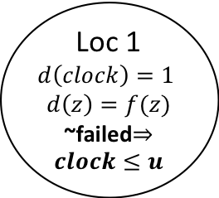
Another Example: Periodically Sending Process
Automaton PeriodicSend(u)
variables: analog
clock: Reals := 0, z:Reals, failed:Boolean := F
actions: send(m:Reals), fail
transitions:
send(m)
pre clock = u /\ m = z /\ ~failed
eff clock := 0
fail
pre true
eff failed := T
trajectories:
evolve d(clock) = 1, d(z) = f(z)
invariant failed \/ clock<=u
send(m)
clock = u /\ m = z /\ ~failed
clock := 0
Loc 1
$$d\left(clock\right)=1$$
$$d\left(z\right)=f(z)$$
~failed$⇒clock≤u$
clock:= 0
fail
true
failed := T

Slide 12
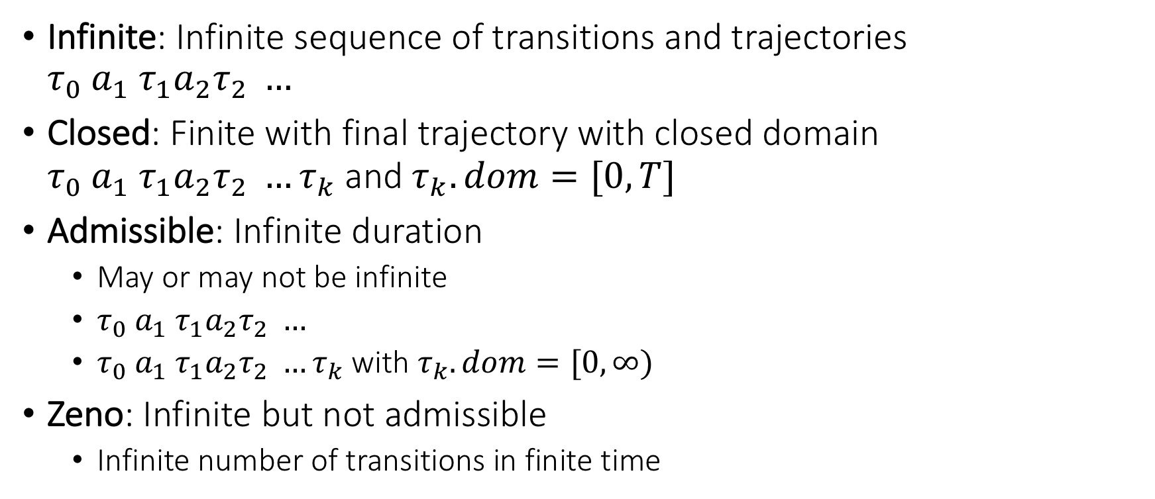
Special kinds of executions
Infinite: Infinite sequence of transitions and trajectories $τ_{0} a_{1} τ_{1}a_{2}τ_{2} …$
Closed: Finite with final trajectory with closed domain $τ_{0} a_{1} τ_{1}a_{2}τ_{2} …τ_{k}$ and $τ_{k}.dom=[0,T]$
Admissible: Infinite duration
May or may not be infinite
$τ_{0} a_{1} τ_{1}a_{2}τ_{2} …$
$τ_{0} a_{1} τ_{1}a_{2}τ_{2} …τ_{k}$ with $τ_{k}.dom=[0,∞)$
Zeno: Infinite but not admissible
Infinite number of transitions in finite time

Slide 13


Zeno’s Paradox
Achilles, the fastest athlete, greatest warrior
Zeno, Greek philosopher
whatever!
You couldn’t even beat a turtle
Achilles runs 10 times faster than than the tortoise, but the turtle gets to start 1 second earlier. Can Achilles ever catch Turtle?
Lesson: Mixing discrete transitions with continuous motion can be tricky!
After 1/10th of a second, Achilles reaches where the Turtle (T) started, and T has a head start of 1/10th second.
After another 1/100th of a second, A catches up to where T was at t=1/10 sec, but T has a head start of 1/100th
…
T is always ahead …
Notes:
5 mins.

Slide 14

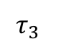

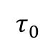

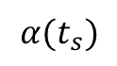
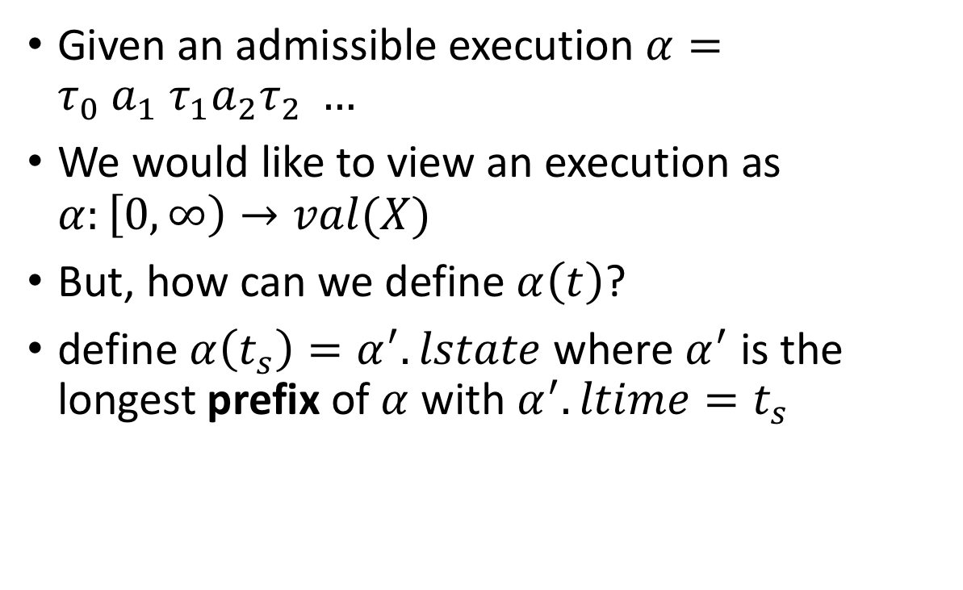

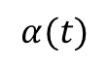
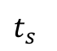
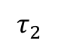




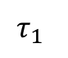

Defining stability of hybrid automata
Given an admissible execution $α=τ_{0} a_{1} τ_{1}a_{2}τ_{2} …$
We would like to view an execution as $α:\left[0,∞\right)→val(X)$
But, how can we define $α\left(t\right)$?
define $α\left(t_{s}\right)=α^{′}.lstate$ where $α^{′}$ is the longest prefix of $α$ with $α^{′}.ltime=t_{s}$
$$α(t_{s})$$
$$τ_{3}$$
$$τ_{2}$$
$$τ_{1}$$
$$α(t)$$
$$τ_{0}$$
$t_{s}$
time

Slide 15
Hybrid Instability
Each of the modes of a walking robot are asymptotically stable
Is it possible to switch between them to make the system unstable?
Walk
Run

Slide 16
Yes! By switching between them the system becomes unstable
Walk
Run
Notes:
So, 300 years of mathematics developed for analyzing physics will not be enough for analyzing systems like self-driving cars where computers switch between different physics

Slide 17
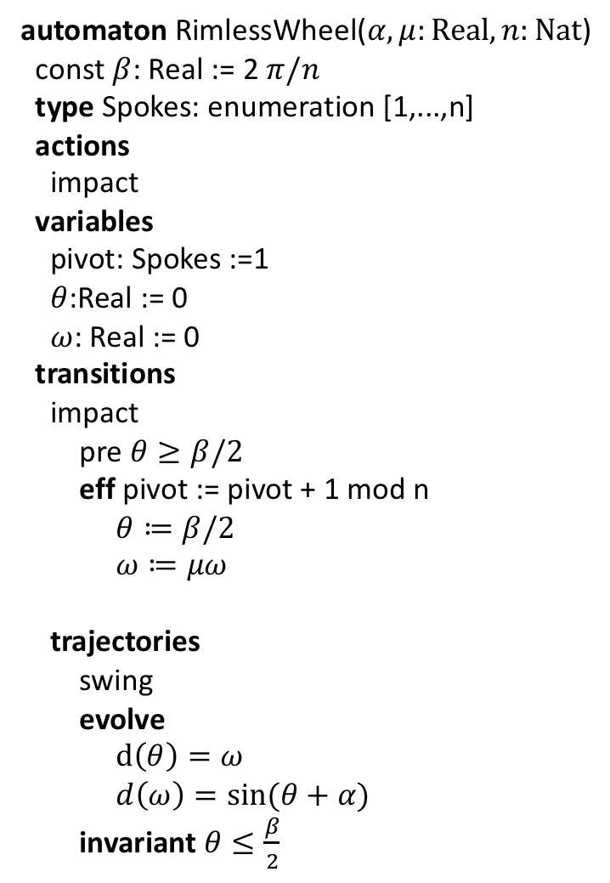

Rimless wheel
automaton RimlessWheel($α,μ:Real, n:Nat$)
const $β$: Real := 2 $π/n$
type Spokes: enumeration [1,...,n]
actions
impact
variables
pivot: Spokes :=1
$θ$:Real := 0
$ω$: Real := 0
transitions
impact
pre $θ≥β/2$
eff pivot := pivot + 1 mod n
$θ≔β/2$
$ω≔μω$
trajectories
swing
evolve
$d\left(θ\right)=ω$
$d\left(ω\right)=\sin{(θ+α)}$
invariant $θ≤\frac{β}{2}$

Slide 18
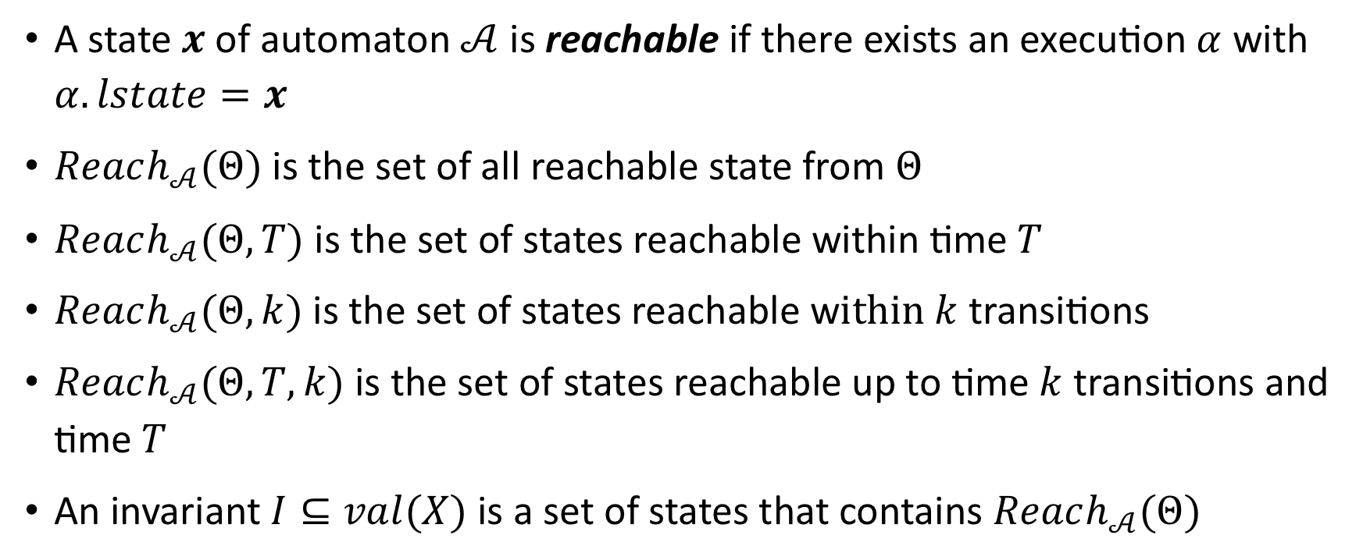
Invariants and reachability
A state $x$of automaton $𝒜$ is reachable if there exists an execution $α$ with $α.lstate=x$
$Reach_{𝒜}(Θ)$ is the set of all reachable state from $Θ$
$Reach_{𝒜}(Θ,T)$ is the set of states reachable within time $T$
$Reach_{𝒜}(Θ,k)$ is the set of states reachable w$ithin k$ transitions
$Reach_{𝒜}(Θ,T,k)$ is the set of states reachable up to time $k$ transitions and time $T$
An invariant $I⊆val(X)$ is a set of states that contains $Reach_{𝒜}(Θ)$

